Slide 1
Shopping Expert
Project Presentation

Slide 2

Team Member:
Cheng Tian
Yukai Tan

Slide 3
Introduce our project:
Our project is to help people make offline shopping more convenient, enjoyable and comfortable. To help people improve their offline shopping experience.

Slide 4
Background
Today, online shopping is the most popular way of shopping. But with more and more online shopping, people are also aware of the limitations of online shopping. I believe that everyone has encountered something beautiful on the website, but it is not what the picture looks like when they buy it at home. Or the size of clothes and shoes is not suitable and needs to be returned. Or maybe the urgently needed items were delivered in a month. These are problems that cannot be avoided when shopping online. So we thought, if we can make the advantages of online shopping, such as centralized display of item information, provide search functions, etc., make an app for people who shop offline, is it a reasonable solution?

Slide 5
Customer
Our users are people who would like to shop offline.

Slide 6
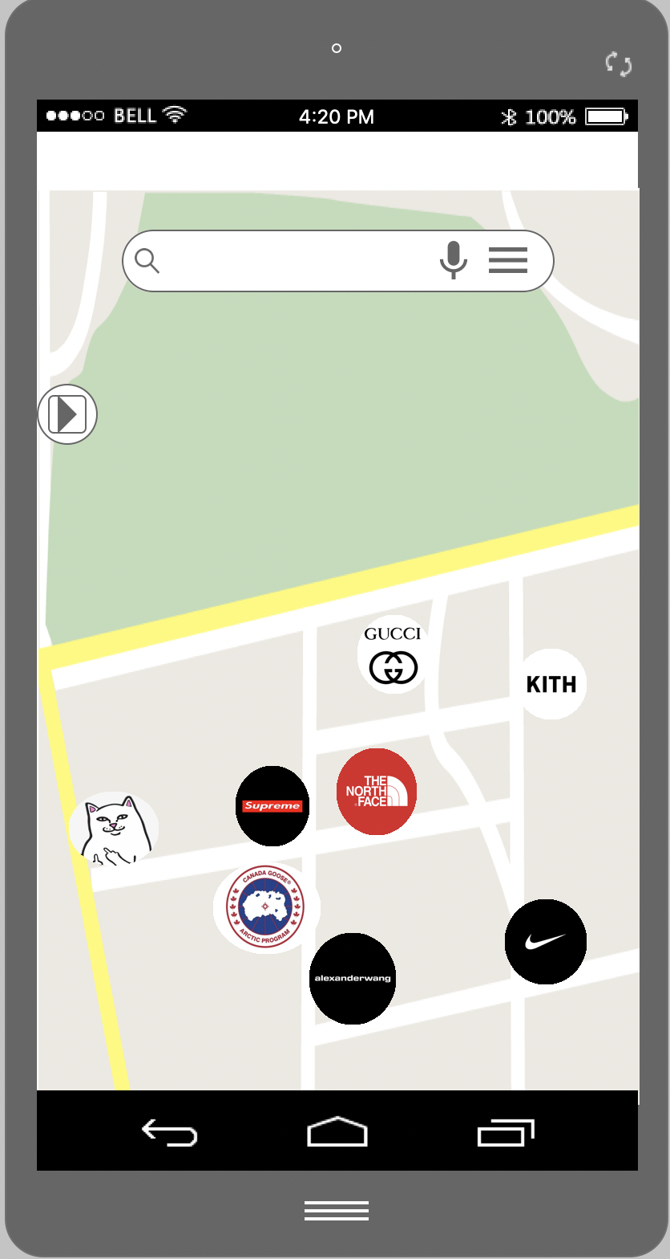
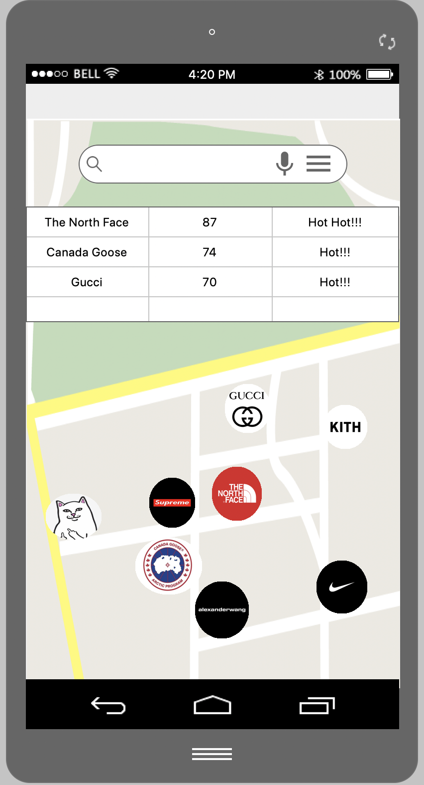
Feature1 and 2
We will provide a map that will show the locations of all the stores within the map area and their names and icons.
And we will provide a button to show the hottest shops in the area. This feature will be similar to a leaderboard so that customers can understand directly.

Slide 7
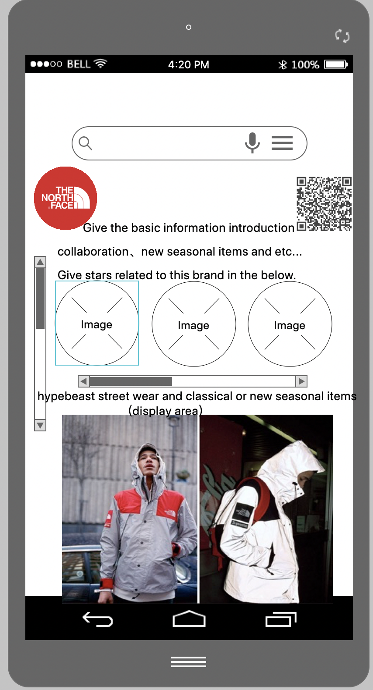
Feature 3, 4 and 5
After zoom in or zoom out. When there is only one store left on the map, our app will automatically switch to the detailed display mode for customers.
And no matter in which mode, we provide a search function so that customers can search to find the store they want.
Return function

Slide 8
The end
We find that more and more people prefer offline shopping than before. Sometimes, one day of shopping online is not as effective as one hour of offline shopping. So we think that offline shopping still has a lot of potential to be tapped. Our intention in making this app is to provide people with a better offline shopping experience and make shopping be a more fun, comfortable and efficient activity.

